Slide 1
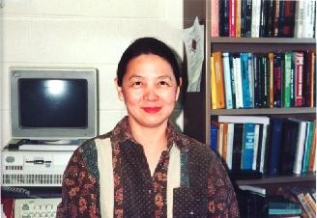
Conference on Bayesian Modeling, Computation, and Applications: in honor of Lynn Kuo (LK-70)
Professor of Statistics, University of Connecticut & Fellow ASA
Joined UConn in 1986
Ph.D. (1980), from the Department of Mathematics, University of California at Los Angeles
RESEARCH INTERESTS: Bioinformatics, Biostatistics, Computational Statistics, Decision Theory, Empirical Bayes Estimation, Longitudinal Data Analysis, Nonparametric Bayesian Statistics,
Software Reliability, Survey Sampling and
Survival Analysis

Slide 2
Visiting Positions / Fellowships
Department of Mathematics, National Taiwan University
Department of Community Medicine and Health Care, UCHC
Department of Statistics, Stanford University
Department of Operations Research, Naval Postgraduate School, Monterey
Division of Statistics, University of California at Davis
ASA/USDA, Statistical Survey Institute, Statistical Reporting Service, Research Division, USDA, Washington, DC
Department of Applied Mathematics and Statistics, State University of New York at Stony Brook, NY
Department of Statistics, University of Michigan, Ann Arbor. MI
System Analyst, Deep Space Network Operation, Jet Propulsion Lab., Pasadena, CA

Slide 3
Notable Publications
Bayesian Bioassay Design, Annals of Statistics, 1983
The Admissibility of the Empirical Distribution Function, (with M.P. Cohen), Annals of Statistics, 1985
Computations of Mixtures of Dirichlet Processes, SIAM Journal on Scientific and Statistical Computing, 1986

Slide 4
Notable Publications
Linear Bayes Estimators of the Potency Curve in Bioassay, Biometrika, 1988
Composite Estimation of Totals for Livestock Surveys, Journal of American Statistical Association, 1989
On the Admissibility of the Linear Estimators of the Poisson Mean Using Linex Loss Functions, (with D.K. Dey), Statistics and Decisions, 1990
A New Empirical Bayes Estimator with Type II Censored Data, (with D.K. Dey), Computational Statistics & Data Analysis, 1991
Bayes Computations in Survival Models via the Gibbs Samplers, (with A.F.M. Smith), 1992
Bayesian Computation for Software Reliability, (with T. Yang), Journal of Computational and Graphical Statistics, 1995

Slide 5
Notable Publications
Nonparametric Bayesian Bioassay Including Ordered Polytomous Response, (with A. E. Gelfand), Biometrika, 1991
Minimax Estimation of a Variance, (with T.S. Ferguson), Annals of the Institute of Statistical Mathematics, 1994
Bayesian Computation for Nonhomogeneous Poisson Processes in Software Reliability, (with T. Yang), Journal of the American Statistical Association, 1996
Variable Selection for Regression Models, (with B. Mallick), Sankhya B , 1998

Slide 6
Notable Publications
Discrete Choice Models Based on the Scale Mixtures of Multivariate Normal Distributions, (with Z. Chen), Sankhya B, 2002
Bayesian and Profile Likelihood Change Point Methods for Modeling Cognitive Function Over Time, (with C. Hall, J. Ying, and R. Lipton), Computational Statistics and Data Analysis, 2003
Forecasting Stock Prices Using a Hierarchical Bayesian Approach, (with J. Ying, G. Seow), Journal of Forecasting, 2005

Slide 7
Notable Publications
Detecting Differentially Expressed Genes Using Calibrated Bayes Factors (with F. Yu, and M. H. Chen), Statistica Sinica, 2008
Bayesian Hierarchical Modeling and Selection of Differentially Expressed Genes for the EST Data, (with F. Yu, M-H. Chen, P. Huang & W. Wang), Biometrics, 2011
Estimating Bayesian Phylogenetic Information Content (with P.O. Lewis, M.H. Chen, L.A. Lewis, K. Fučíková, S. Neupane, Y. B. Wang, and D. Shi) Systematic Biology, 2016

Slide 8
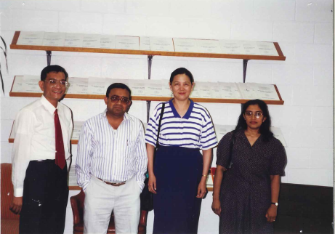
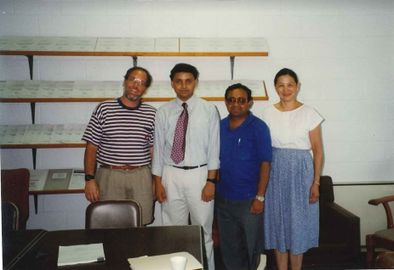
Ph.D. students adviser and associate adviser
Lynn has produced 13 Ph.D. students, they are well placed in academics, government and industries
Currently quite a few students are working under her supervision
She was also associate adviser of many students

Slide 9
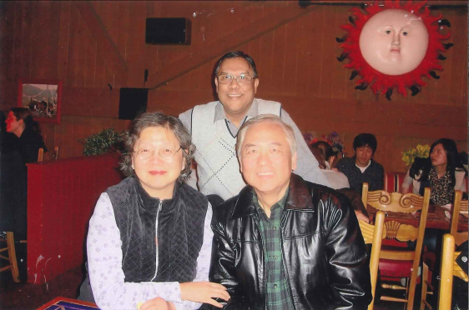
LK as an integrated part of the department

Slide 10
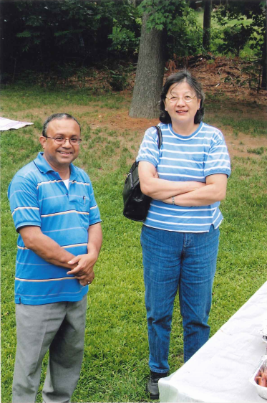
LK as an integrated part of the department

Slide 11
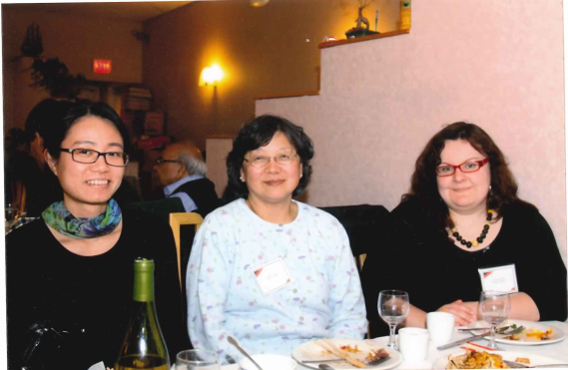

Slide 12
HAPPY BIRTHDAY TO LYNN KUO

