Slide 1
An Innovative Design to combine a PoC Study with Dose Range
Qiqi Deng, Xiaofei Bai, Naitee Ting
Boehringer-Ingelheim
All points in the slides represent my personal point of view. They do not necessarily reflect the position of Boehringer-Ingelheim

Slide 2
Drug Development Process
Drug Discovery
Non-clinical Development
Clinical Development
Phase I Clinical pharmacology (PK/PD, MTD)
Phase II Drug efficacy/safety, dose ranging
Phase III Long-term, large scale, confirmatory
Phase IV Post-market

Slide 3
Phase II Clinical Trials
First Phase II is Proof of Concept (PoC)
Followed by dose-ranging trials
Objective is to propose dose(s) for Phase III design
Moving doses down to MinED
If dose-range is not found in Phase II, it will be too expensive in later Phases

Slide 4
Overview of dose finding process (non-oncology)
Phase I
Phase II
Efficacy
Toxicity
MED
MaxED
MTD/MFD
Notes:
Oncology:
phase I and II population are usually different.
Improvement in safety profile for new generation of therapy

Slide 5
Proof of Concept (PoC) Study
Typically two treatment groups
Parallel design
Placebo controlled
Use a dose at MTD or close to MTD
Short term, clinical efficacy endpoint (surrogate markers may be used at times)
Moderate sample size

Slide 6
Sample size for a PoC design
People come to statistician asking for sample size
This is the opportunity for a statistician to contribute to the study design
Assuming δ is positive
Assuming variance = 1
N is calculated given α and β

Slide 7
Proof of Concept
Hypothesis testing
Primary endpoint is clinical efficacy
Pre-specified two-sided alpha could be >= 0.05
Power may be greater than 80%
Go/No Go decision

Slide 8
Propose a tool to help with communications
A communication tool is proposed to help the team members in understanding the risks
Discussions should happen before breaking blind
After the design is finalized
Clear Go/No Go criteria can be documented

Slide 9
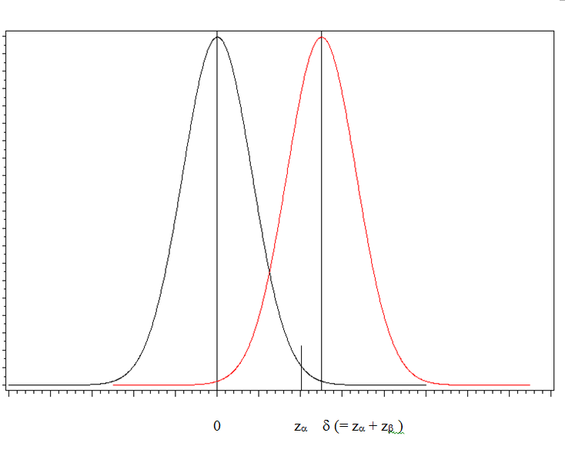

Slide 10
Dose Ranging Clinical Trials
More than two treatment groups
Typically three test doses – low, medium, and high
It is recommended to test 4 to 5 doses
Should cover a wide dose range
Design is exploratory in nature
Estimating efficacious doses

Slide 11
Minimum Effective Dose (MinED)
Imagine the difficulty in a PoC study
It was MTD in PoC
From a dose ranging design, there are multiple test doses
When each dose is compared with placebo, there is a PoC discussion
Which dose is efficacious? And the minimal dose?

Slide 12
The Proposal
Early sign of efficacy “ESOE”
Change PoC from a “Go/NoGo” into “Go Fast”, “Go Slow”, and “NoGo”
Use of a two-stage design
Start with a two group PoC
MTD vs Placebo

Slide 13
The Proposal

Slide 14
The Proposal
Design the PoC study with pre-specified α, β and δ, (assuming δ is positive)
Assuming σ = 1
Sample size is calculated with these assumptions
This PoC has N per group

Slide 15
The Proposal

Slide 16
The Proposal
Sample size per group at ESOE is n₁
Difference between n₁ and N is n₂
Under “Go Fast” strategy, recruit n₂ additional subjects into high dose and placebo
Also add doses to this study to make it a dose ranging design

Slide 17
The Proposal

Slide 18
The Proposal

Slide 19
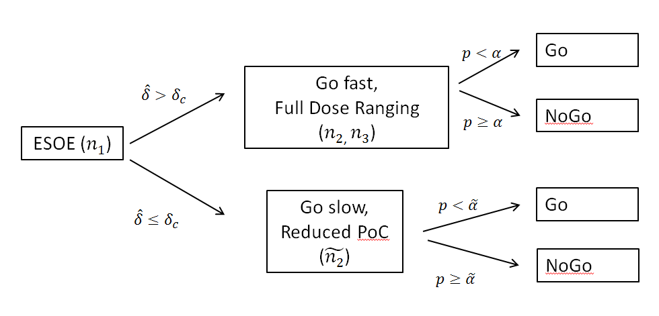
The Proposal

Slide 20
The Proposal

Slide 21
Example

Slide 22
Example
If the drug is not promising - ($X≤c$ or equivalently$\hat{ δ}≤δ_{c})$
Then enroll additional ${\tilde{n}}_{2}=30$ patients
Compare high dose vs placebo at 60 pts
Test PoC under $\tilde{α}$=0.15
If “NoGo”, stop development
If “Go Slow”, design a dose ranging trial

Slide 23
Example
If “Go Fast” then add 3 doses with 50 patients per group
Continue to recruit 70 patients for high dose and placebo
A total of 350 patients (100 on high, 100 on placebo, and 50 on the three lower doses

Slide 24
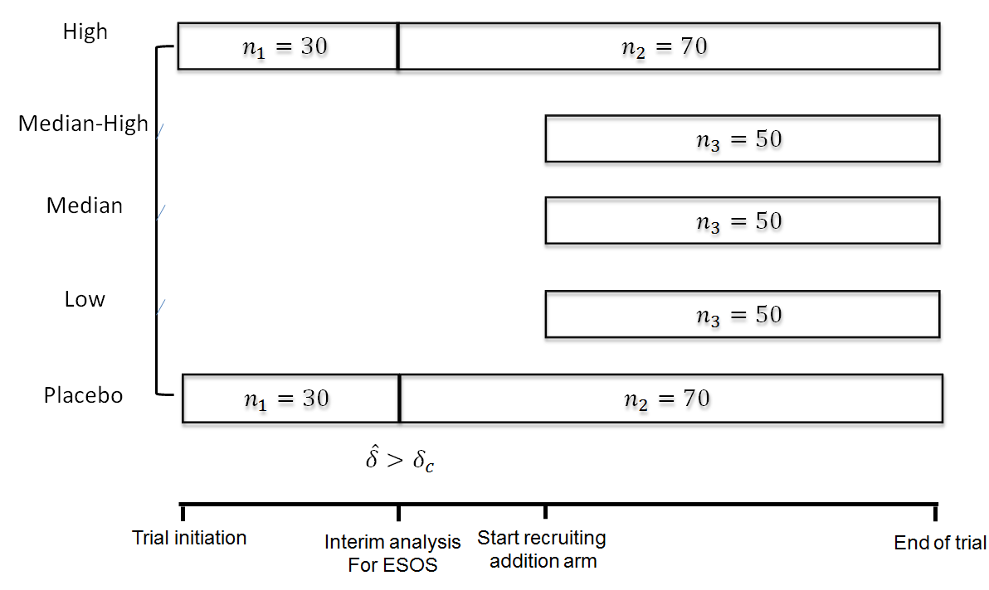

Slide 25
Summary
Break down the “Go NoGo” into “Go Fast”, “Go Slow”, and “No Go”
Set ESOE, and design a traditional PoC at α and β
Perform an interim analysis. If not ESOE, continue with fewer subject and test at $\tilde{α}$
Determine “No Go” or “Go Slow” when complete

Slide 26
Summary
If ESOE achieved at interim, then “Go Fast”
Expand to include low does and make this study a dose ranging trial
With 2:1:1:1:2 – imbalanced randomization

