Slide 1
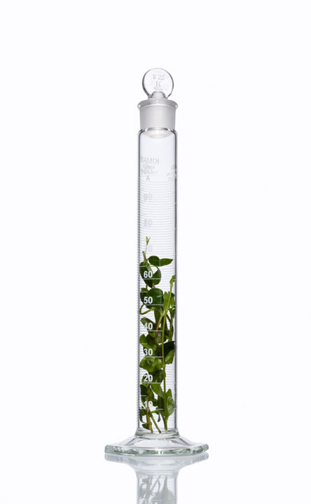
Use of the VG (Virtual Twins Combined with GUIDE) Method in the Development of Precision Medicines
Jia Jia, Qi Tang, Wangang Xie, Richard Rode

Slide 2
Disclosure
This presentation was sponsored by AbbVie. AbbVie contributed to the design, research, and interpretation of data, writing, reviewing, and approving the publication. Jia Jia and Wangang Xie are employees of AbbVie, Inc. Qi Tang is a former employee of AbbVie, Inc. and now employed by Sanofi US. Richard Rode is a former employee of AbbVie.

Slide 3
Outline
Background and Motivation
VG Method: Combination of Virtual Twins and GUIDE
Simulations
Case Study
Discussion and Conclusions

Slide 4
Background and Motivation

Slide 5
Treatment Effects Are Often Heterogeneous
Efficacious and Safe
Inefficacious but safe
Study Population
Efficacious but Unsafe
Inefficacious and Unsafe
Notes:
From patient perspective: precision medicine promises to increase benefits and reduce risks by improving both the safety and efficacy of medical products.
By further elucidating why some patients respond or do not respond to a drug, and why some experience adverse reactions while others do not, we may be able to use this information to tailor drug indications to certain populations, this improving safety and efficacy of drugs by specifying the population(s) in which they should be used

Slide 6
Current Practice of Subgroup Analysis
Pre-select demographic variables and variables potentially predictive of treatment effects (predictive variables)
-E.g. Race = “White”
Pre-determine cutoff values for continuous variables
-E.g. Age > 55
Pitfalls:
No type I error control
Unable to identify subgroup(s) of interest if “true” cutoff is different from the pre-specified cutoff
Unable to identify subgroup(s) defined by more than one predictive variable
Notes:
Current: pre-defined subgroup analysis
No Type I error control, missed the true cutoff point and/or the second predictive variable.

Slide 7
Why Use Tree-Based Methods?
Evaluation of heterogeneous treatment effects is essentially a classification problem
Classification and Regression Tree (CART) methods are well known for their power of solving complicated classification problems
Capable of handling large number of covariates
Fast search algorithms for identification of optimal cutoff
Avoid over fitting issues
Ease of interpretation
Gender =Male
Baseline = Severe
n=50 ∆=-1
n=100 ∆=2
n=40 ∆=0

Slide 8
Tree-Based Methods for Identifying Predictive Variables
RECPAM (Negassa et al., 2005)
Interaction Tree (Su et al., 2008, 2009)
Model-Based Recursive Partitioning (Zeileis et al., 2008)
Subgroup Identification based on Differential Effect Search (SIDES) (Lipkovich et al., 2011)
Virtual Twins (Foster et al., 2011)
Qualitative interaction tree (Dusseldorp and Van Mechelen, 2013)
Generalized, Unbiased, Interaction Detection and Estimation (GUIDE): treatment interactions (Gi) (Loh et al., 2015)

Slide 9
The Virtual Twins (VT) method
Step 1: Estimate Individual Treatment Effect (ITE)
Patient A in Clinical Trial
Patient A’s Virtual Twin
Outcome under the assigned arm
Predicted outcome under the other arm
Difference
Step 2: Identify heterogeneous effects using CART methods

Slide 10
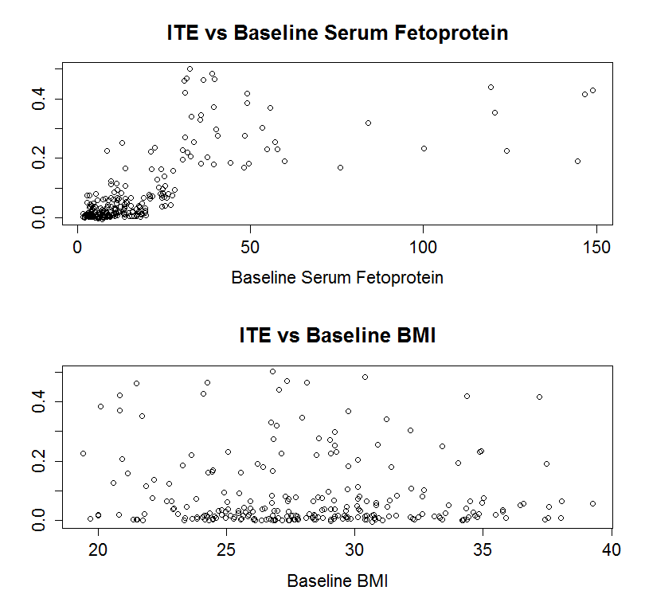
Examples of ITE
An Example of ITE vs. a Predictive Variable
ITE
A Baseline Lab Measure
An Example of ITE vs. a Noise Variable
ITE

Slide 11
Another way of estimating ITE (under research)
ITE = R – P
ITE: Benefit (-1 <= B <= 1), the higher the value of B the better the effect of the drug. (negative value means harmful drug)
R: Response (0 OR 1): if tumor responded, R = 1; otherwise, R = 0.
P: likelihood of response (0 <= p <= 1), value based on previous data or statistical model.
Reference:
Johannes E. Wolff, Robert E.Brown, Jamie Buryanek, Stefan Pfister, Tribhawan S.Vats, and Michael E. Rytting, Preliminary Experience With Personalized and Targeted Therapy for Pediatric Brain Tumors. Pediatric Blood Cancer, 2012; 59; 27 – 33
Johannes E Wolff, Michael Rytting, Tribhawa Vats, Peter Zage, Joann Ater, Anita Mahajan, Shiao Woo, John Kuttesch, Leena Ketonen, and Peter Thall. Treatment of Recurrent Diffuse Intrinsic Pontine Glioma, Experience of MDAnderson Cancer Center. Journal of Neurooncology. 2010 January; 106(2): 391 – 397.

Slide 12
VG Method: Combination of Virtual Twins and GUIDE

Slide 13
The VG Method
Step 1.
V step: Obtain ITE Using Random Forests (Same as VT)
Step 2.
G step: Identify subgroup(s) with heterogeneous treatment effects using GUIDE (VT uses CART)
Comparison Feature | GUIDE | CART
Variable Selection | No bias | Biased toward selection of continuous variables, followed by categorical variables having many levels

Slide 14
Simulations

Slide 15
Simulations
500 simulations per scenario
n=200 per group
Y: continuous response variable
T: treatment indicator. 1: treatment, 0: control
X₁,… X₁₅: 15 covariates
For continuous covariates, pairwise correlation is 0.5
For binary covariates, event rates generated from Beta (2,3)
Main treatment effect and standard deviation: ∆= 0.2; σ=0.5
Effect of predictive variable and prognostic variable (if any): 0.5 unless specified
Scenario | Predictive Variable and Effect | Prognostic Variable | Noise Variables
No Prognostic | X₁ continuous | None | X₂,…, X₁₅ continuous
No Prognostic Mix | X₁ binary (effect 0.2) | None | X₂ binary; X₃,…, X₁₅ continuous
Prognostic | X₁ continuous | X₂ continuous | X₃,…, X₁₅ continuous

Slide 16
How to Fairly Compare Different Methods?
Metrics used for comparison purposes:
Type I error: probability of identifying a subgroup when there are no subgroups
Power: probability of identifying a subgroup when there is a subgroup
Conditional true discovery rate: conditional probability of correctly identifying the predictive variable when a subgroup is identified
Fair comparison: compare power and true discovery rate under the same type I error rate

Slide 17
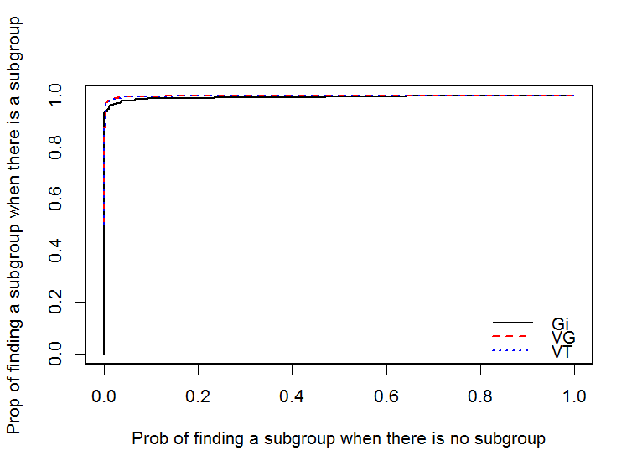
Results under No Prognostic Scenario: Power vs Type I Error
VG and VT have essentially identical performance and both exhibit slightly higher power (chance of identifying a subgroup when there is a subgroup) than Gi
Power
Type I Error

Slide 18
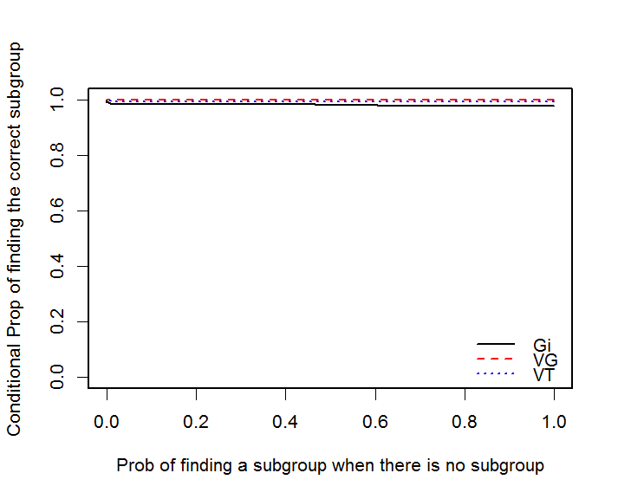
Results under No Prognostic Scenario: Conditional True Discovery Rate vs Type I Error
VG and VT have essentially identical performance and both exhibit slightly higher conditional true discovery rate (conditional probability of identifying the correct subgroup given a subgroup is identified) than Gi
Conditional True Discovery Rate
Type I Error

Slide 19
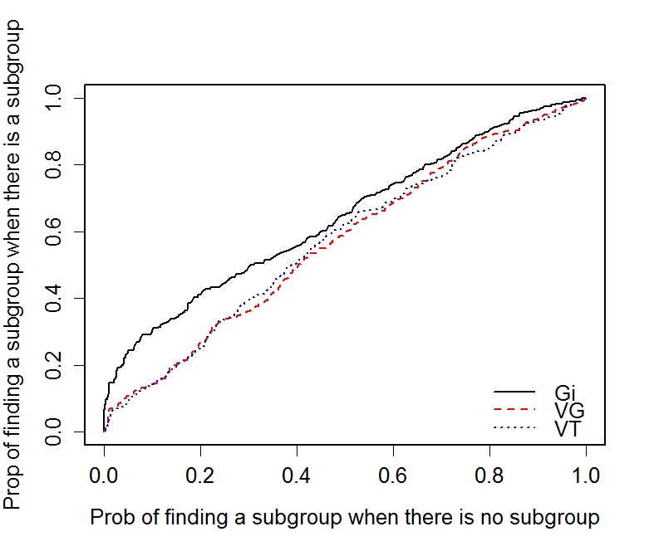
Results under No Prognostic Mix Scenario: Power vs Type I Error
VG and VT have lower power (chance to identify a subgroup) than Gi;
VG has similar power as VT
Power
Type I Error

Slide 20
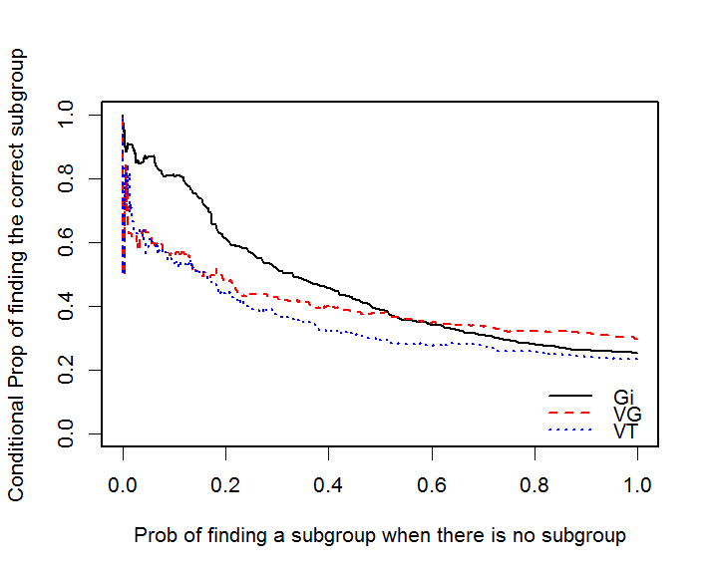
Results under No Prognostic Mix Scenario: True Discovery Rate vs Type I Error
VG has larger true discovery rate than VT;
VG has smaller true discovery rate than Gi when type I error is small
True Discovery Rate
Type I Error

Slide 21
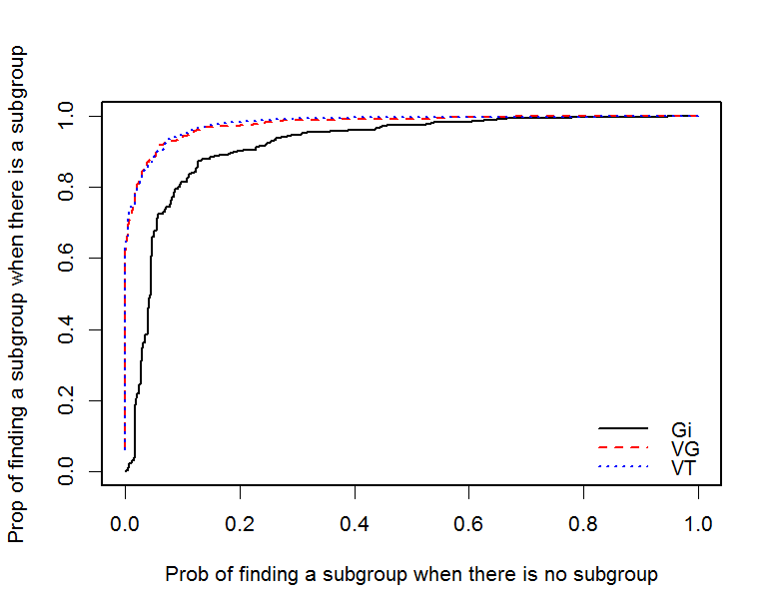
Results under Prognostic Scenario: Power vs Type I Error
VG and VT have increased power relative to Gi
Power
Type I Error

Slide 22
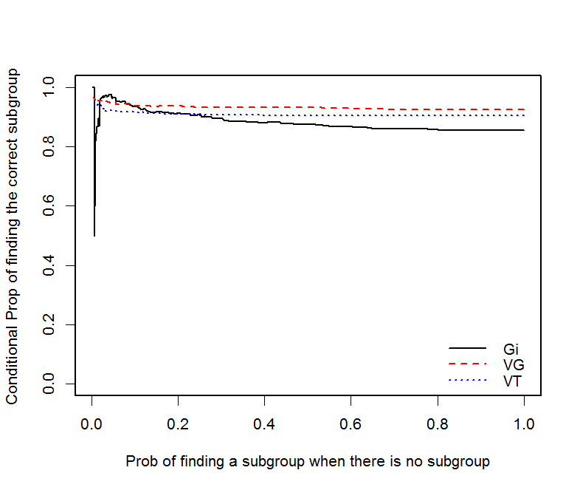
Results under Prognostic Scenario: Conditional True Discovery Rate vs Type I Error
VG have increased conditional true discovery rate relative to VT;
VG performs similar to or better than Gi
True Discovery rate
Type I Error

Slide 23
Case Study

Slide 24
Alzheimer’s Disease Example
Endpoint: Change from Baseline to Week 12 in ADAS-Cog 11 subscale score
Treatment arms: Investigational vs Placebo
Predictors:
Age, sex, race, baseline Mini-Mental State Examination (MMSE), ADAS-Cog 11 subscale score (change from Screening to Baseline), apolipoprotein E4 (APOE4),…, (17 covariates)
We applied VT, VG and GI to this study
ITE = Y|Placebo – Y|Treatment
Y: ADAS-Cog 11 subscale score change from Baseline to Week 12 (lower = better; bigger ITE = better treatment effect)

Slide 25
Case study: Analysis Procedure
Training set:
Study 1 – 3
N = 287
Applying VT, GI and VG on training set to obtain signature.
Testing set:
Study 4
N = 113
Applying signature on testing set to obtain subgroups.
Assessing the difference of treatment effect between subgroups.
Calculating bootstrap CI for the mean of the endpoint of the two subgroups.

Slide 26
Analysis on training dataset (N = 287)
ADAS Cog-11 Score change from Screen to Baseline
Gi and VT weren’t able to find a signature
Sample size
Average ITE
Y: ADAS Cog-11 Score change from baseline to week 12
Subgroup 3 has better treatment effect as indicated by the larger ITE value.
ITE = Y|Placebo – Y|Treatment
Y: ADAS Cog-11 Score change from baseline to week 12 (lower = better; thus bigger ITE = better treatment effect)
Notes:
We need to interpret the change score from Screen to baseline.
Can you first check how the change score calculated? Is it baseline minus screening?
You may add a note in the slide notes that this change score reflects the learning ability and smaller value indicates stronger learning ability. So, the interpretation of the subgroup is that people with less learning ability has better response. This is a result very useful for future trial design. People may want to stratify randomization according to the change score.

Slide 27
Analysis on testing dataset (N = 113)
We use the bootstrap method to estimate the uncertainty about the effects in the identified subgroup.
Signature (Subgroup) | Mean response (Y**) | Bootstrapped 95% CI
X* <= -0.1666 (sub2, N = 65) | -1.05 | (-1.16, -0.95)
X* > -0.1666 (sub3, N = 48) | -2.93 | (-3.08, -2.80)
Difference between Above Two Subgroups | 1.88 | (1.76, 2.01)
*X: ADAS Cog 11 Score Change from Screen to Baseline
**Y: ADAS Cog-11 Score change from baseline to week 12 – the smaller the better
Details about how to construct bootstrap confidence intervals can be found in Loh et al. 2015

Slide 28
Discussion and Conclusions

Slide 29
Discussion and Conclusions
Treatment effects are often heterogeneous
Data mining techniques should be considered to avoid pitfalls of common one variable at a time subgroup analyses
VG is proposed to combine the advantages of Virtual Twins and GUIDE
VG outperforms VT when there are mixed variable types (i.e., binary and continuous variables)
VG and VT outperform Gi when prognostic effect is as strong as predictive effect
Gi outperforms VG and VT when there are mixed variable types
Above conclusions about the performances are based on limited simulation studies
No method is uniformly better across different scenarios.
Specific simulations for method selection are necessary.
Type I error control is essential for reproducible subgroup findings
The prediction accuracy of ITE is still needed to be improved.
Notes:
Extensive simulations in settings close the dataset to be analyzed should be conducted before choosing a method for identifying heterogeneous treatment effects and corresponding tuning parameters

Slide 30
Future Work
Add permutation and bootstrap into the analysis procedure.
Extensive simulation based on real data.
Try to mimic the information/noise that exist in the real data.
Improve the ITE prediction accuracy.
For now we are using Random Forest with 500 trees in the simulation and 2000 trees in case study.
We assume better prediction of ITE will result in better performance of VG method.

Slide 31
Reference
Dusseldorp, E. and Van Mechelen, I. Qualitative interaction trees: a tool to identify qualitative treatment-subgroup interactions. Statistics in Medicine. 2013;33(2):219-37
Foster JC, Taylor JMG, Ruberg SJ. Subgroup identification from randomized clinical trial data. Statistics in Medicine. 2011;30(24):2867-80.
Lipkovich, I., Dmitrienko, A., Denne, J., and Enas, G. Subgroup identification based on differential effect search — a recursive partitioning method for establishing response to treatment in patient subpopulations. Statistics in Medicine. 2011;30:2601–21
Loh W-Y. Regression trees with unbiased variable selection and interaction detection. Statistical Sinica. 2002;12(2):361-86.
Loh W-Y, He X, Man M. A regression tree approach to identifying subgroups with differential treatment effects. Statistics in Medicine. 2015;34(11):1818-33.
Negassa, A., Ciampi, A., Abrahamowicz, M., Shapiro, S., and Boivin, J. R. Tree-structured subgroup analysis for censored survival data: validation of computationally inexpensive model selection criteria. Statistics and Computing. 2005;15:231–9.
Su, X., Tsai, C. L., Wang, H., Nickerson, D. M., and Bogong, L. Subgroup analysis via recursive partitioning. Journal of Machine Learning Research. 2009;10:141–58.
Su, X., Zhou, T., Yan, X., Fan, J., and Yang, S. Interaction trees with censored survival data. International Journal of Biostatistics. 2008; 4. Article 2.
Zeileis, A., Hothorn, T., and Hornik, K. Model-based recursive partitioning. Journal of Computational and Graphical Statistics. 2008;17:492–514.

